Slide 1
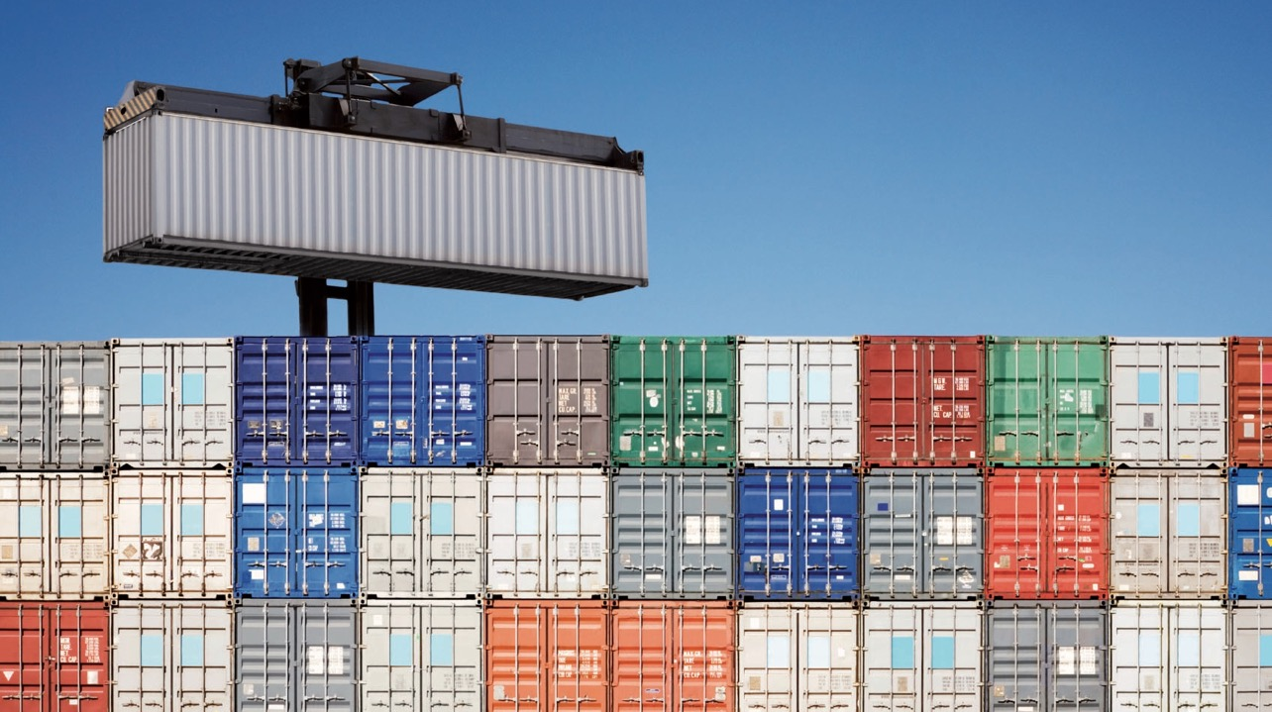
Containers, everywhere
Tim Hynes
Systems Engineer, CTO Office, ANS Group, UK
@railroadmanuk, virtualbrakeman.com

Slide 2
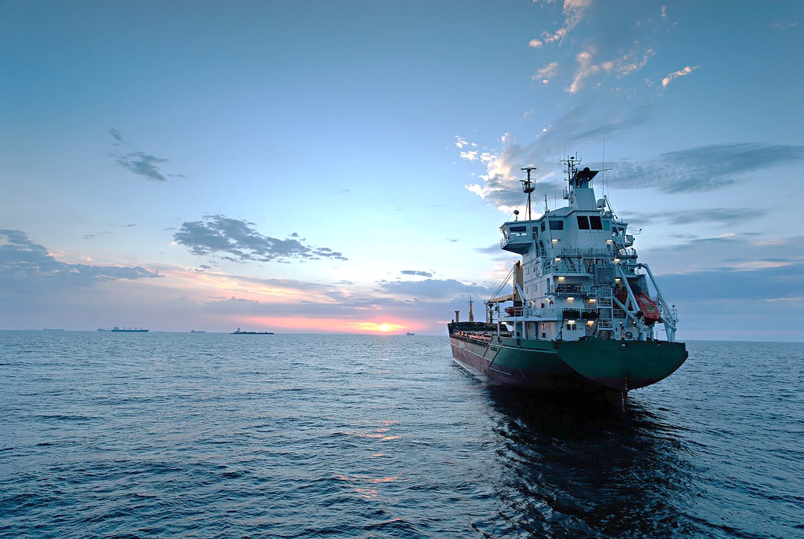
Who am I?
Systems Engineer focused on automation in delivery of infrastructure solutions, and on-boarding of new technologies into business
VMware vExpert 2016, 2017
Cisco Champion 2016, 2017
Multiple VCPs – NSX/vSphere/Cloud
AWS Certified Solutions Architect & Developer Associate

Slide 3
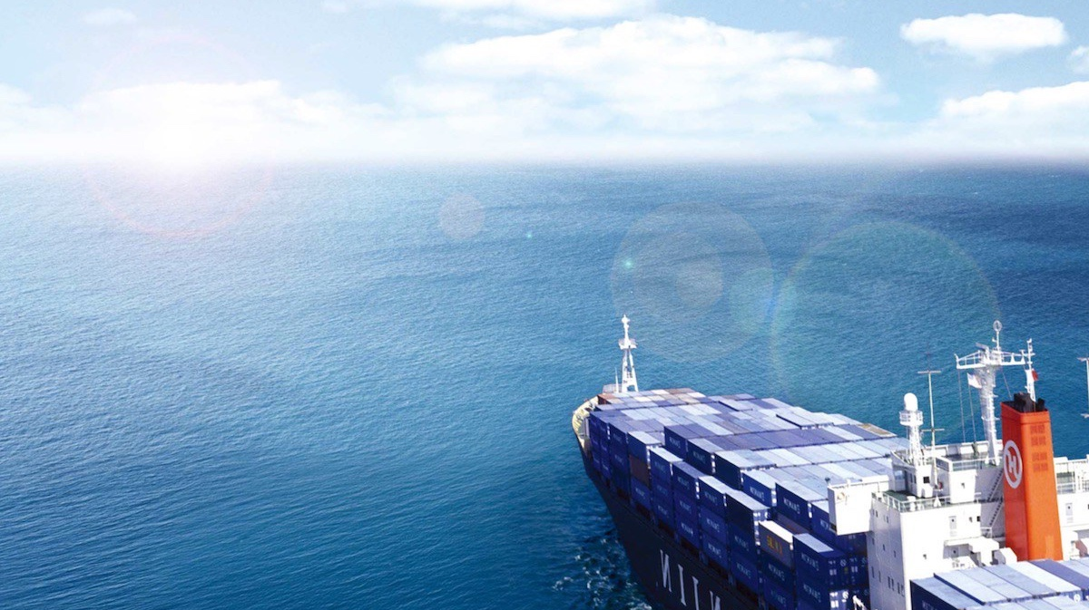
What are we talking about?
What is a container?
Why are containers taking over the world?
How do containers work?
What container technologies should I pay attention to?
What services are there around containers?
What are VMware doing in this space?
Where can I find more information?

Slide 4
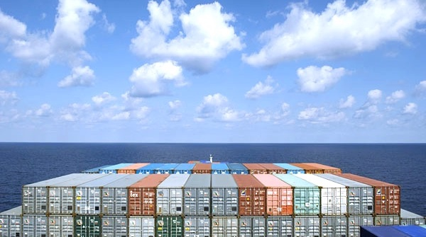
What is a container?

Slide 5
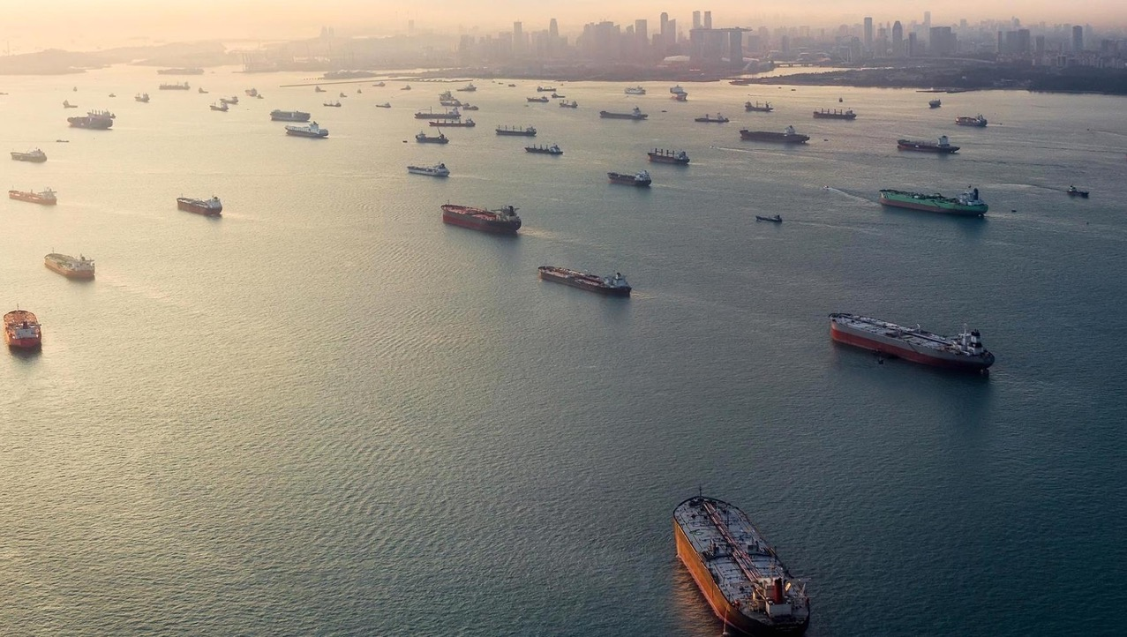
What is a container?
Standard package for software
Portable, run anywhere
Shares OS components of host system
Super quick to start/destroy, suited for immutable, ephemeral infrastructure, particularly micro services
Uses process isolation, rather than OS isolation
Fully software emulation
Based on the concept of images

Slide 6
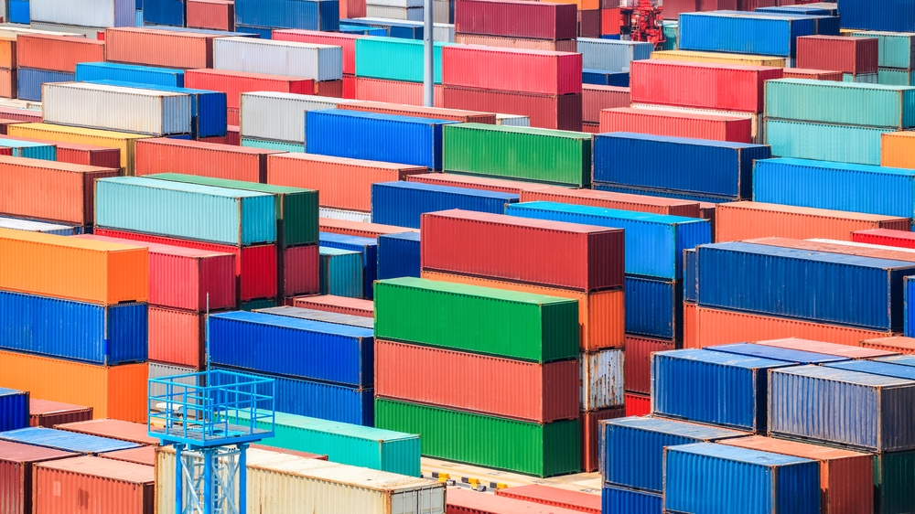
VMs
Containers
VS

Slide 7
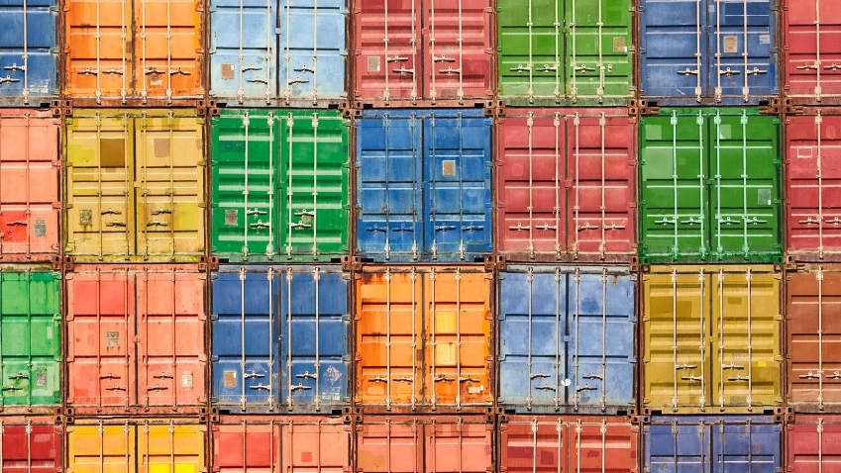

Slide 8
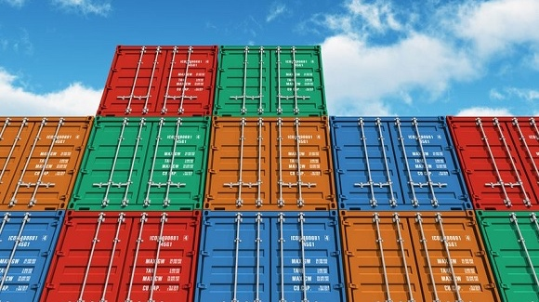
Why are containers taking over the world?
Enable quicker software development cycles
Scale up and down deployed applications quickly
Simple to create, simple to launch, simple to transport
Allow way more consolidation and flexibility than VMs
Let application developers define the environment their applications run in
Images contain only the dependencies needed for the application – reduced footprint, better security

Slide 9
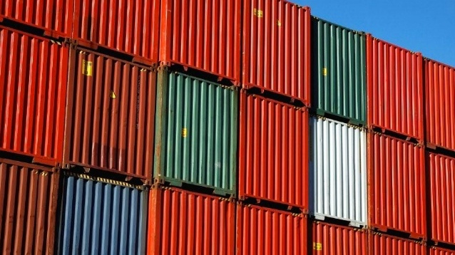
Container lifecycle
Develop
Write application
Deploy
Pull from registry
Update
Pull updated image from registry
Launch one or more replicas
Recycle launched replicas
Package with Dockerfile
Upload to registry

Slide 10
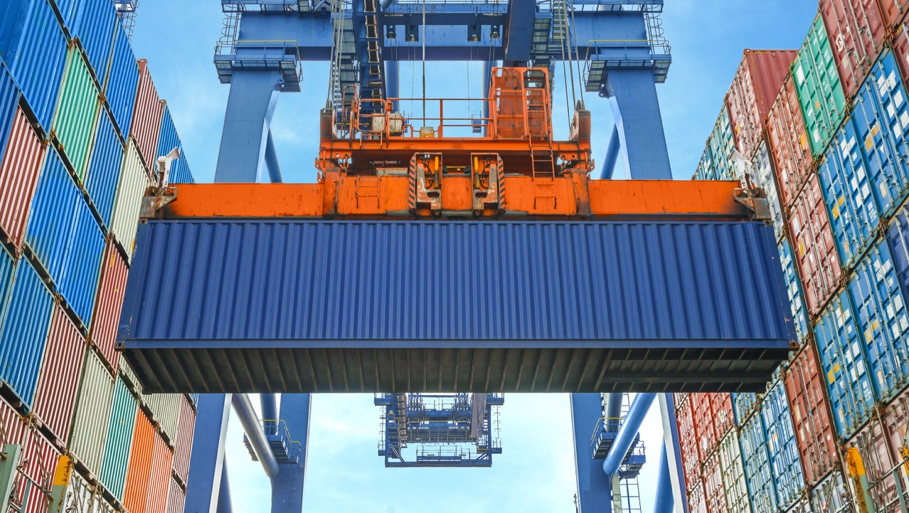
Where do we get our containers from?

Slide 11
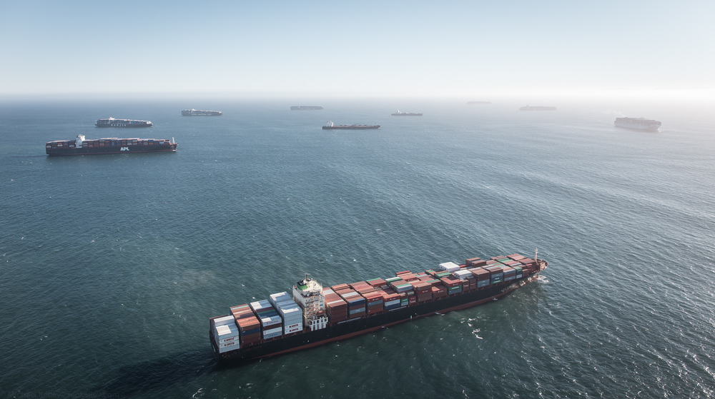
Container Registry
Used to store and distribute container images
Can be private or public
Can integrate with CI/CD application deployment pipelines
Uses labels to track different versions of the same image
Image is pulled to host when launching container image for the first time or can be pulled in advance

Slide 12
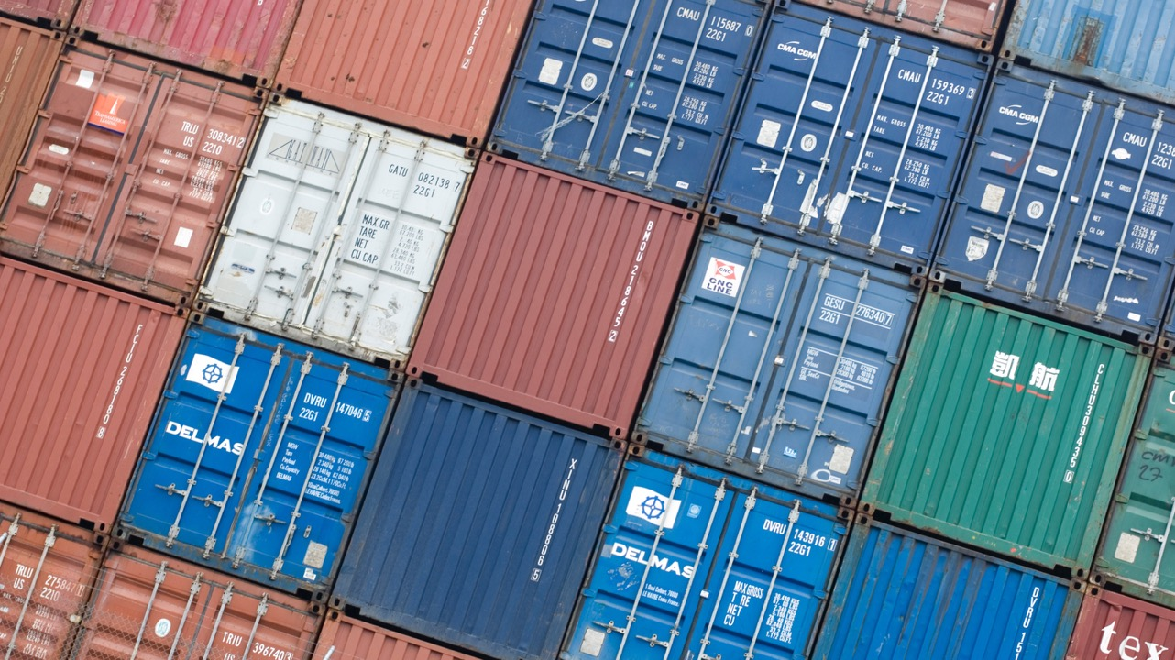
What does a container look like?

Slide 13
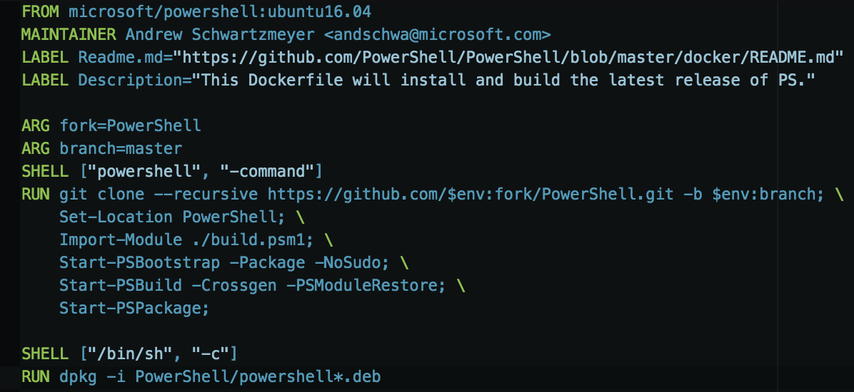

Slide 14
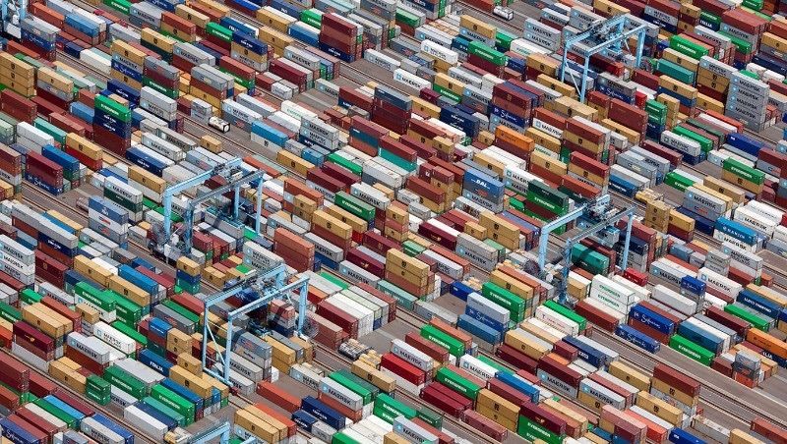
So what do I need to learn?

Slide 15
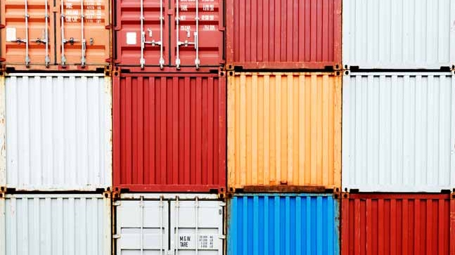

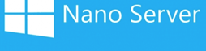
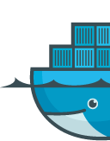
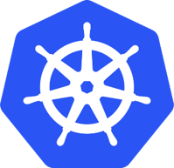

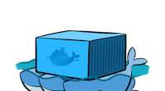

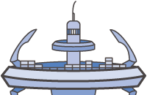

Slide 16
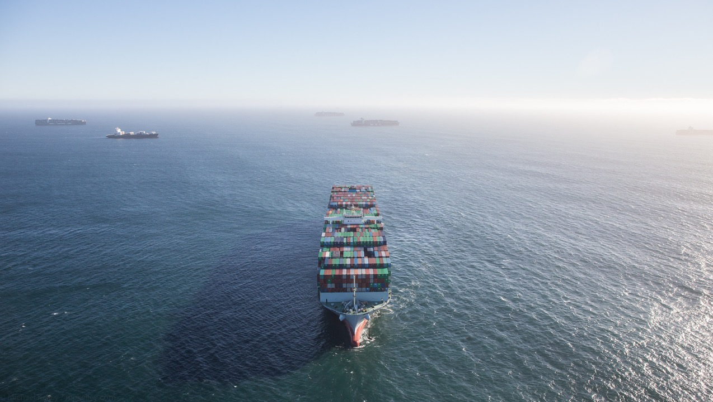
What’s out there?
Runtimes – Docker, rkt, LXC, containerd, runC
Minimal container host OS – Photon OS, Nano Server, Alpine, Ubuntu Snappy Core, RHEL Atomic Host, RancherOS, MicroOS
Schedulers – ECS, Swarm, Kubernetes, Mesosphere, Photon Platform, Tectonic, OpenShift
Network Overlay Providers – Weave, Flannel, Calico, Romana, NSX-T, OVN
Storage Providers – Flocker, vSAN
Containers as a Service – Docker Datacenter, Amazon ECS, GCE, Azure Container Service
Registry – Docker Hub, Artifactory, Quay.io, Google Container Registry

Slide 17
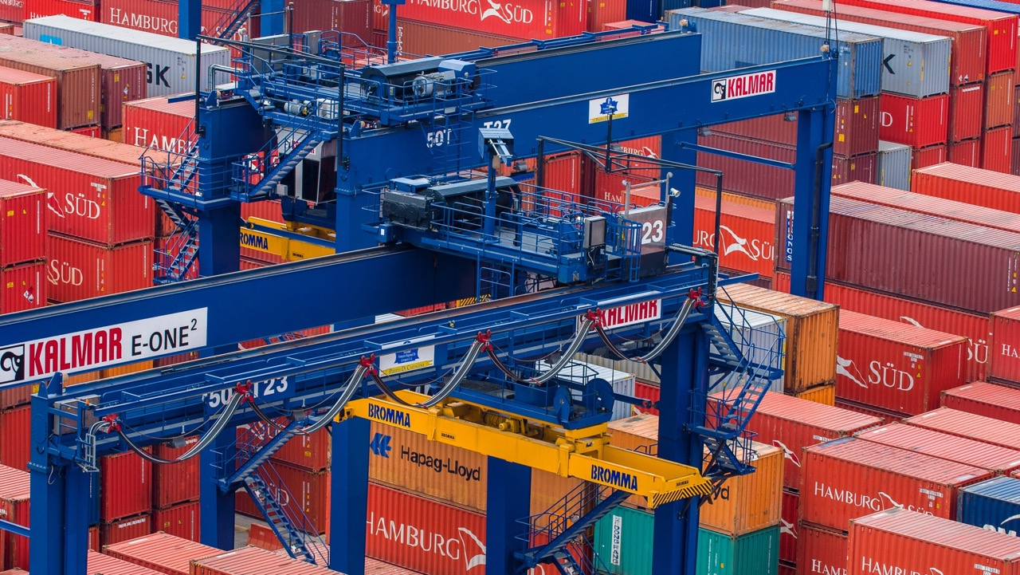
So what’s good to learn then?
Runtime | Docker
Container Host OS | Just…Linux
Scheduler | Kubernetes
Network Overlay Provider | Not that important…I like Weave
Storage Provider | Not that important
CaaS Platform | Not that important…

Slide 18
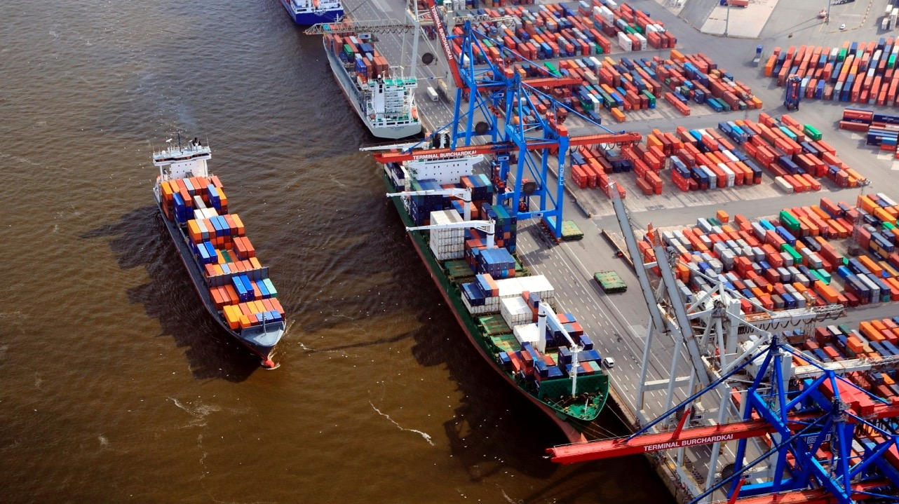
What could possibly go wrong?
We take a multi-tier application hosted in VMs
Application gets broken down into micro-services
Each micro-service has multiple instances launched
Need service discovery and load-balancer components to glue micro-services together
Each component is running in a container, spanned across multiple hosts
Now we have thousands of containers

Slide 19
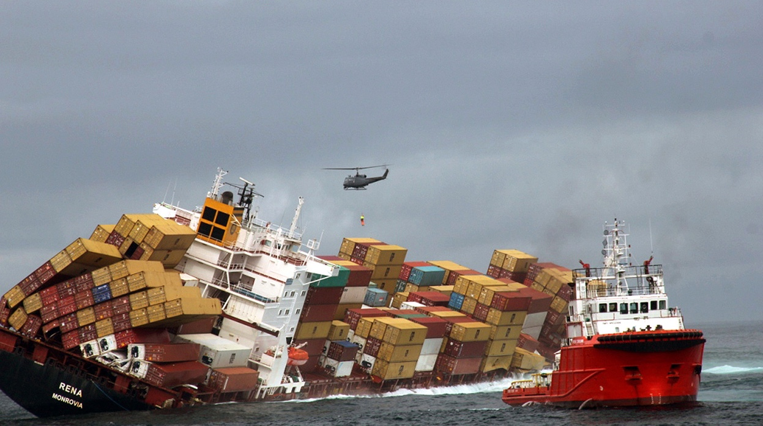
It wasn’t supposed to go down like this…

Slide 20

Enter the container scheduler…
Use desired state for what our application should look like
Desired state is configured in code (YAML, JSON) and fed into the scheduler
Scheduler instantiates our desired state
Scheduler uses bin-fitting to place application components in the best place
Scheduler constantly monitors cluster state, keeps application as we want it

Slide 21
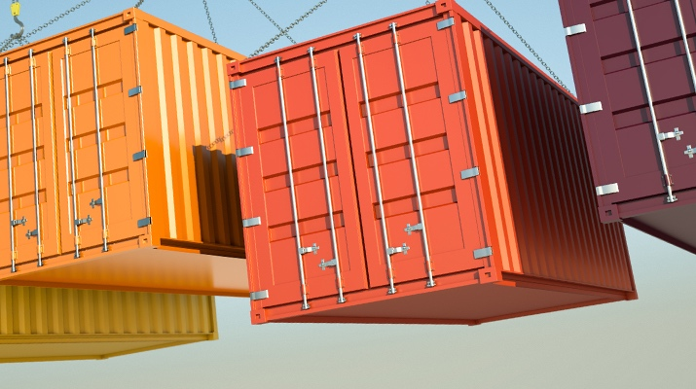
Challenges with containers
Not necessarily suitable for traditional applications
Technologies changing quickly
Persistence of storage
Identifying application dependencies
Very young technology if Windows containers is a requirement
Not as much isolation as with Virtual Machines
Management and monitoring technologies are in development
Need to get your hands dirty to create container images

Slide 22
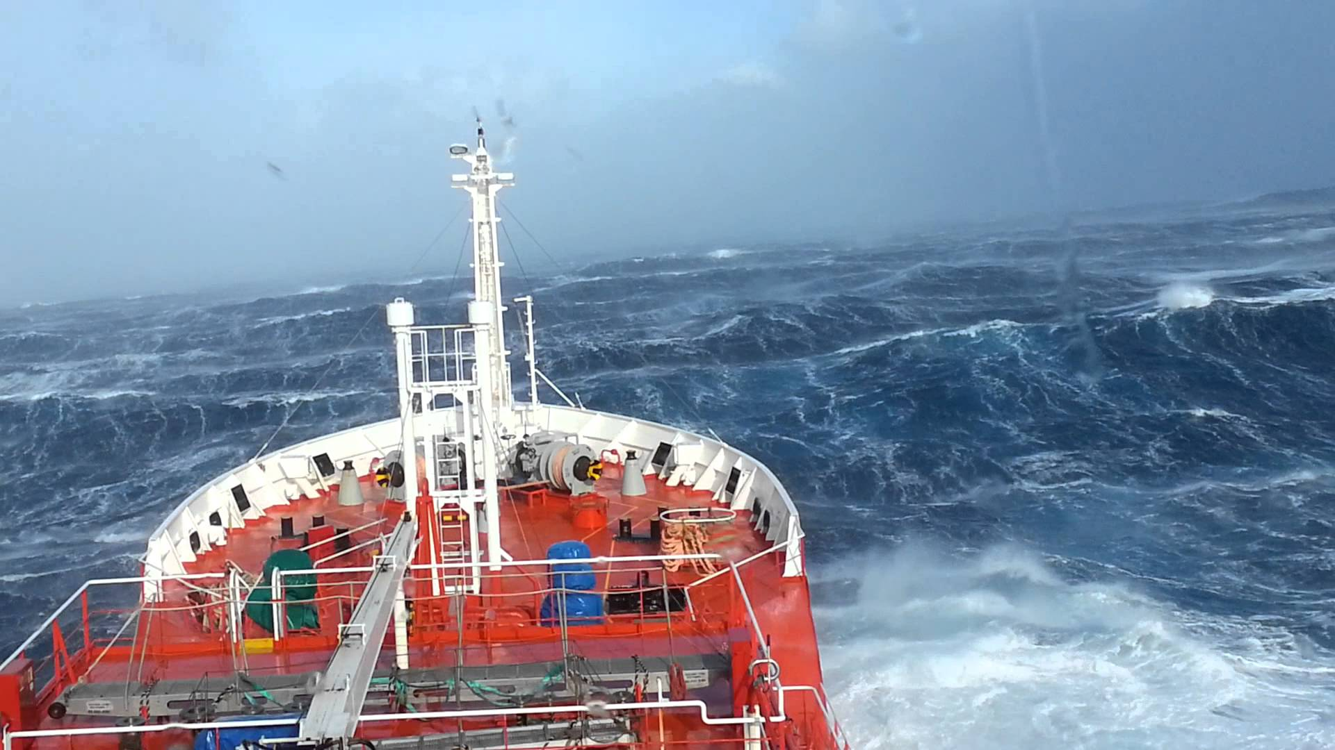
Demo for the demo gods

Slide 23
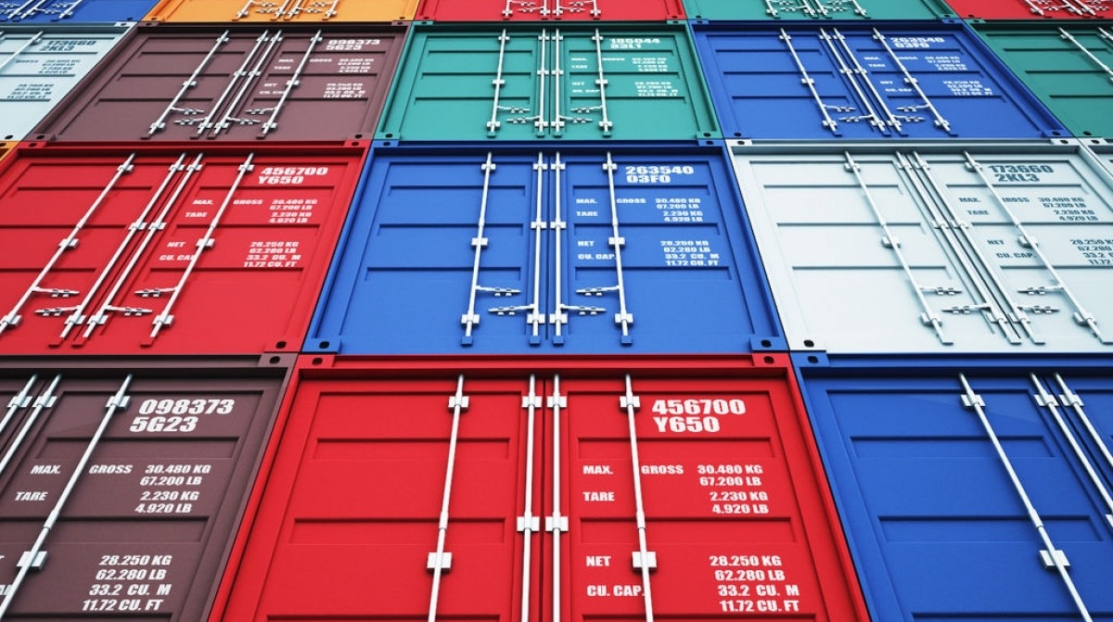
How can VMware help me start my container journey?

Slide 24
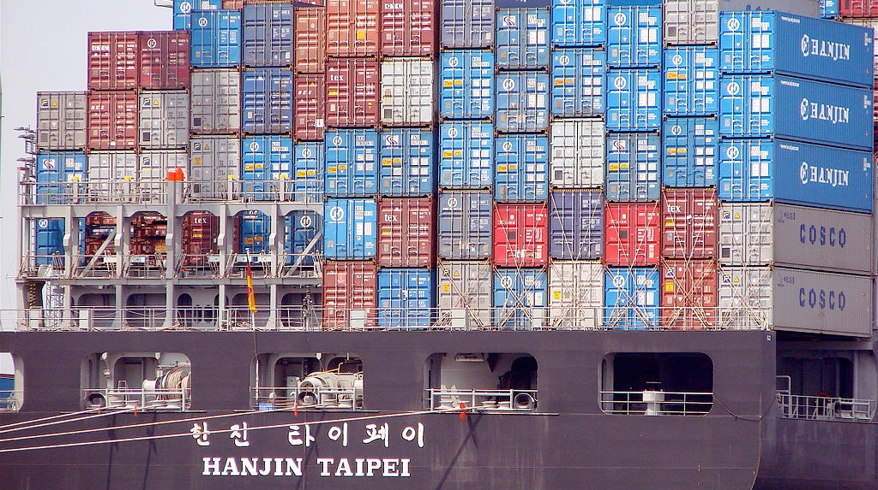
How do containers work with vSphere?
vSphere Integrated Containers (VIC)
Provision containers through Docker runtime
Container within JEVM (just-enough), appears as VM in vCenter under vApp
Web Client plug-in to show container details within client
Project Admiral
Container orchestrator
Integrates with vRealize Automation 7.2+, delivering containers in application blueprints
Project Harbor
Private container registry
Can run as Virtual Machine, or as VIC container

Slide 25
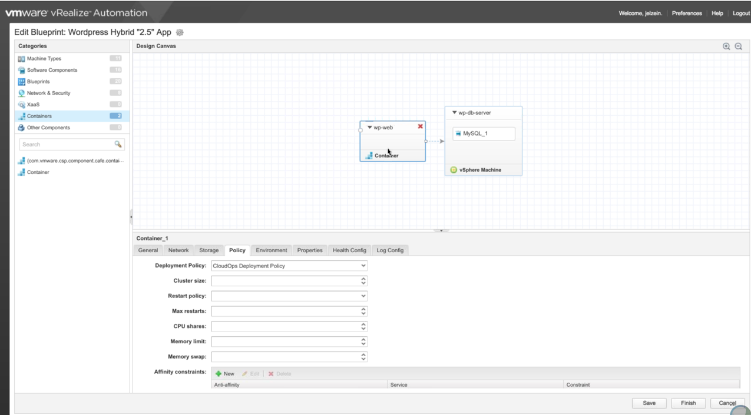

Slide 26
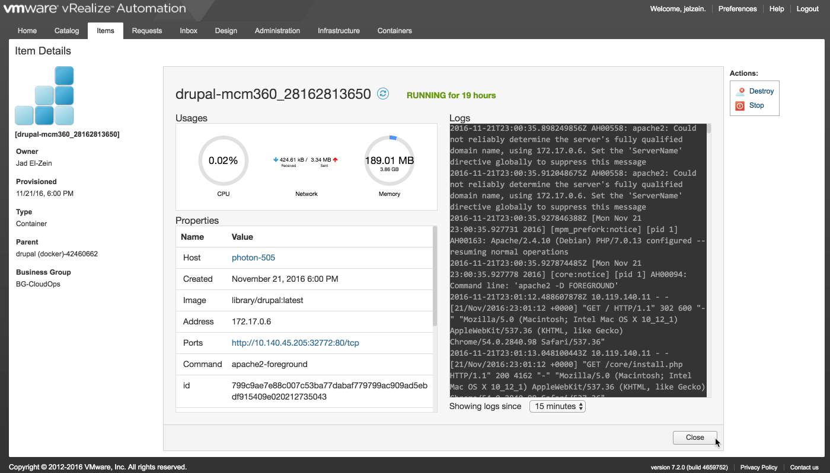

Slide 27
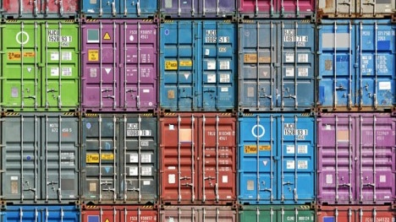
VMware Cloud Native Apps
Photon Platform
Cloud Infrastructure Platform built for cloud native apps
Host controller and container scheduler
Combines ESXi, vSAN, NSX, PhotonOS to provide complete supported platform for containers based on VMware technology stack
Provides fully supported Kubernetes-as-a-Service platform
Photon Controller
Part of Photon Platform
Provides identity and access management using:

Slide 28
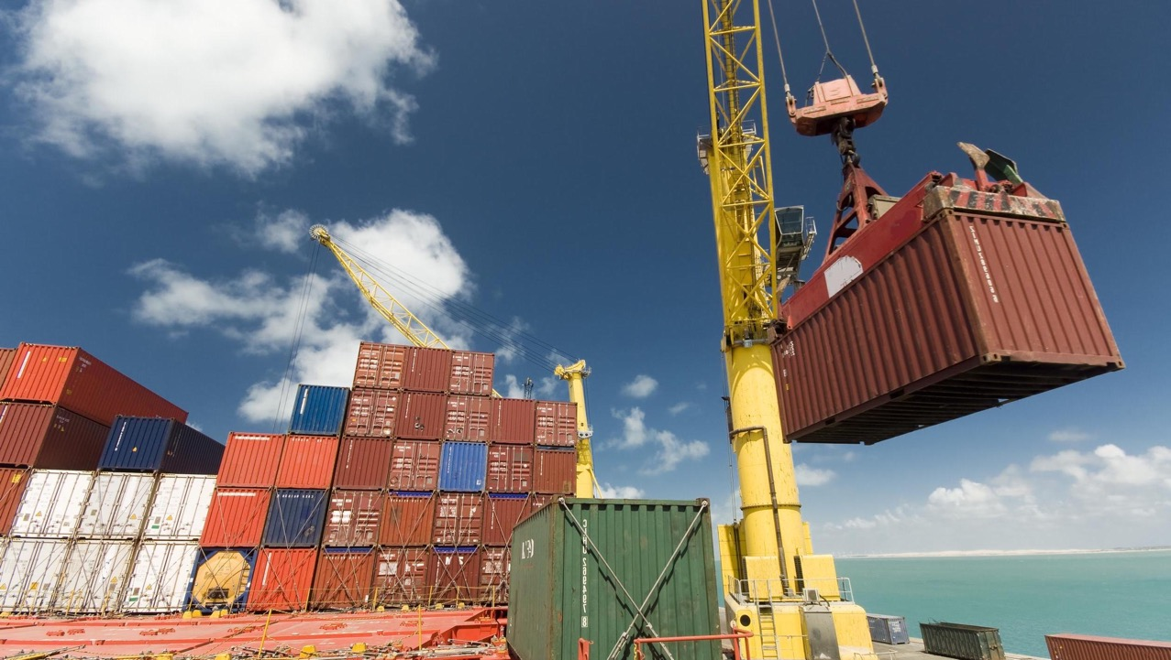
VMware Cloud Native Apps
PhotonOS
Purpose built Linux distribution
Provides identity and access management using:
Project Lightwave
Part of Photon Platform
Provides identity and access management using:
Lightwave Directory Service
Lightwave Certificate Authority
Lightwave Certificate Store
Lightwave Authentication Services

Slide 29
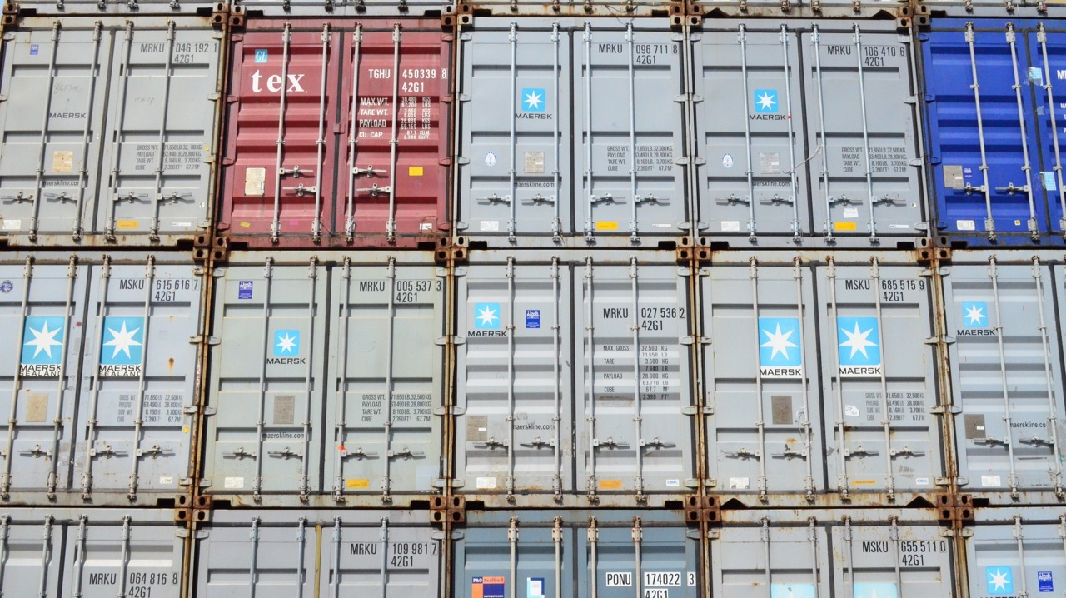
Where can I get started?
Go get Docker for Windows/Mac/Linux
Build your first container
Docker for SysAdmins – Nigel Poulton
Pluralsight, Linux Academy courses
https://thenewstack.io
Try out PhotonOS and VIC
Vagrant Up!

Slide 30
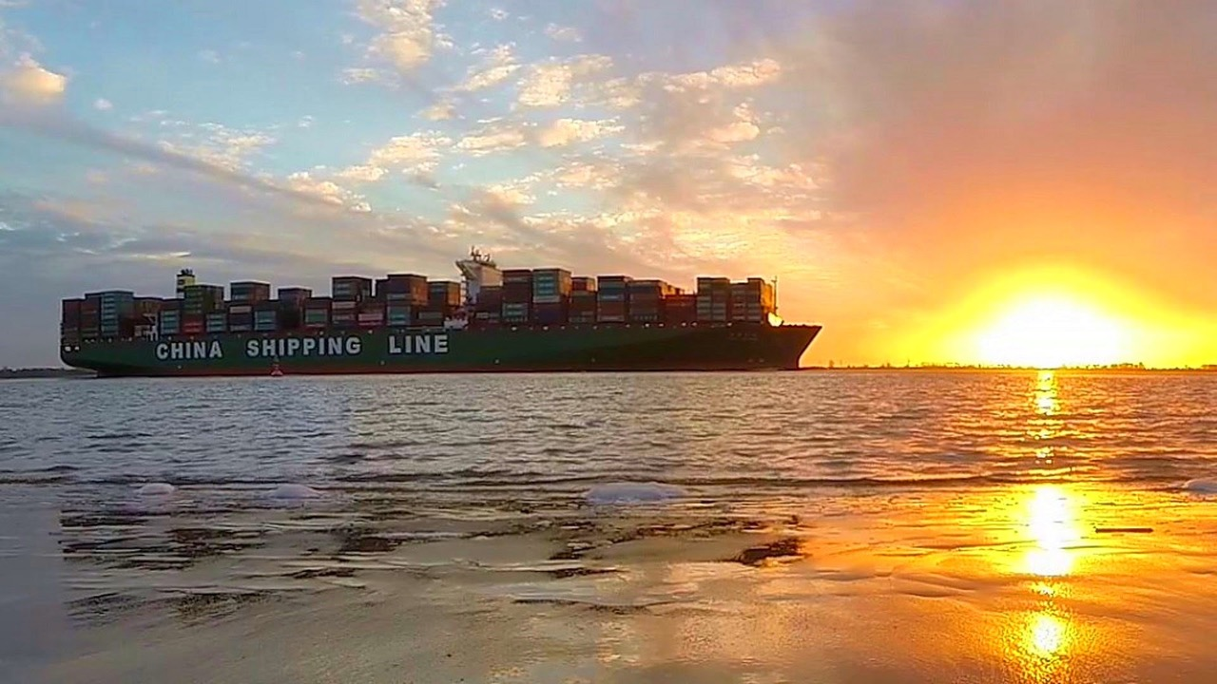
Overview
Containers are happening
Will likely live alongside VMs in our infrastructure
Containers help applications to be delivered more quickly, and with less issues
There is a growing ecosystem of products to help manage them
Containers are not suitable for every workload
VMware are putting tools in place to help vSphere admins adapt
There is a wealth of resources out there to help teach you about container technologies

Slide 31
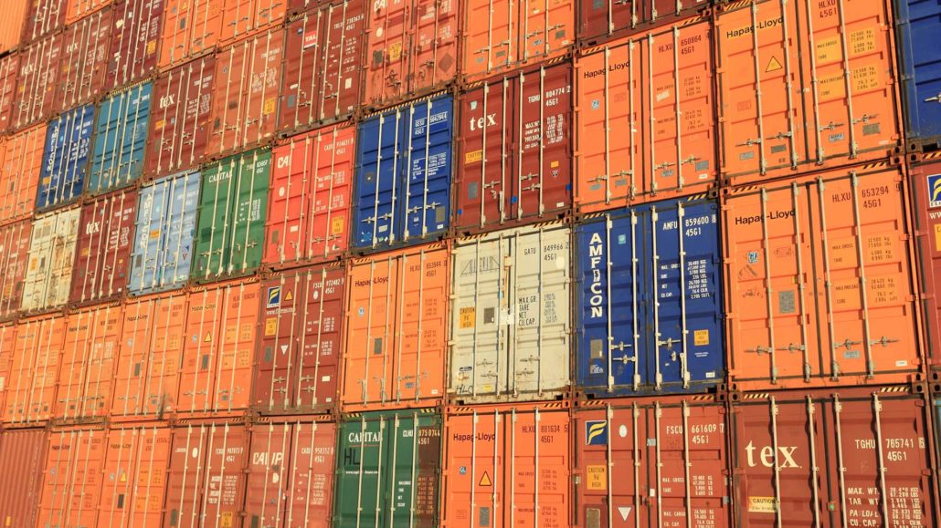
Thanks for listening
Tim Hynes
Systems Engineer, CTO Office, ANS Group, UK
@railroadmanuk,
virtualbrakeman.com

